Slide 1
Open Source Software Engineering
SE ZG587
Kumar Manish
30 Sept, 2023

Slide 2
Session 10 : Life cycle and Methodologies in Open Source Software

Slide 3
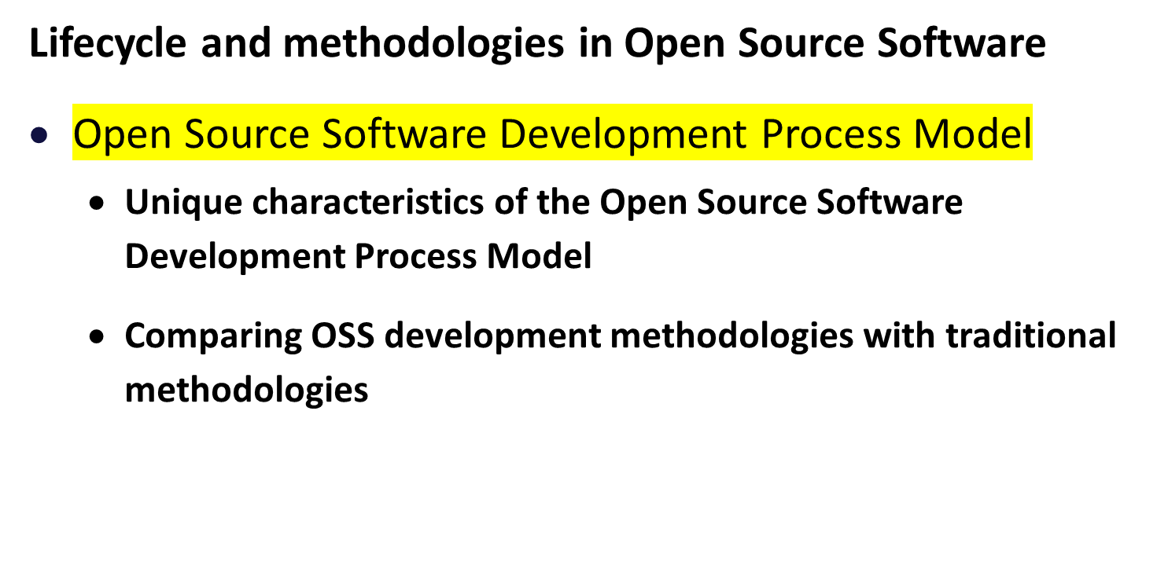
Agenda

Slide 4
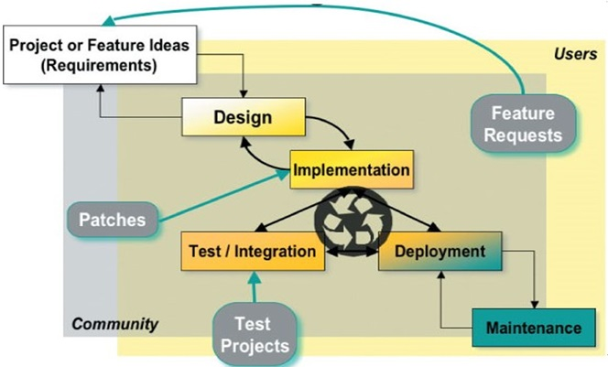
Open Source Software Development Model
Release early, release often
Idea for a new project or new feature or functionality
Design for proposed solution
Implementation by running ( partially or fully)
Development release ( even bug)

Slide 5
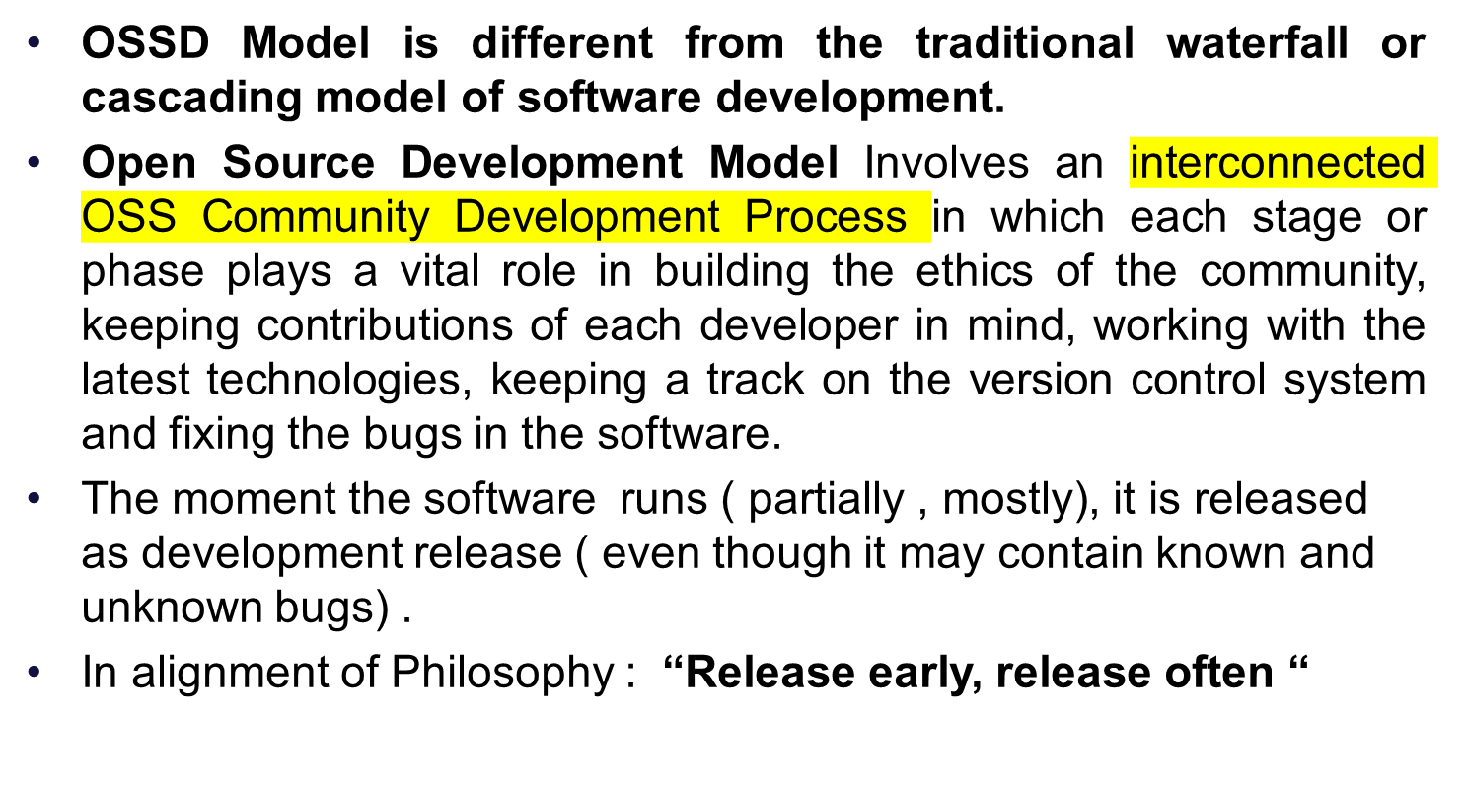
Open Source Software Development Model

Slide 6
Unique characteristic of the OSS Development Process Model

Slide 7
Unique Characteristic of OSS Development model
Release early, release often : The code is made public and a development version of the software is released as soon as the same is available :
  Does not wait for a fully working version
  Advantage : allows for peer review , early bug fixes, comments , Improved code quality, incremental changes - easy to understand and test and correct
Peer Review : Exhaustive review by community
Small, incremental changes : For a larger period of the development cycle, the changes are in the form of small code patches which are easy to understand, test and resolve
  Less likely to introduce cascading or unintended consequences ,
  Beneficial since help in focusing more on testing phase,
  Small changes are less likely to introduce cascading or unintended consequences

Slide 8
Unique Characteristic of OSS Development model
Highly secure code : OS community considers security as very important aspect and any code that raises security concerns is flagged and not included in the project
Continuous quality improvement : Exhaustive peer review and early identifications and fixing of bugs leads to improved code quality
Test projects : Large open source projects also create separate test projects consisting of all large numbers of test suites and make use of automated testing tools.
East user involvement : The end user are continuously involved in all phases of the development model

Slide 9
Comparing OSS development methodologies with traditional methodologies - waterfall / agile

Slide 10
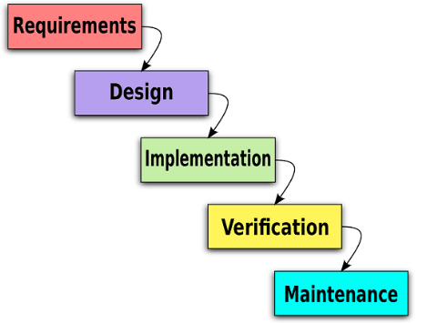
OSSD Vs. Waterfall Model
Traditional software development : Waterfall
Activities arranged in a linear fashion ,
works starts on a particular activity only after the previous activity is completed
OSSD model is different from the traditional waterfall or cascading model of software development .

Slide 11
Agile Methodologies
Agile Methodology emphasizes :
  Small design steps
  Incremental development , and
  Frequent customer interactions and frequent release
The developers and customer together decide on the set of features and capabilities - to be incorporated in the next increment of the software
Each Iteration of development is of few weeks only
The software is then released to the Customers ; who test and use the same and find bugs , and suggest fixes and updates
Agile and OSSD models share many principle and value however ,there are also contrasting differences in the philosophy behind them

Slide 12
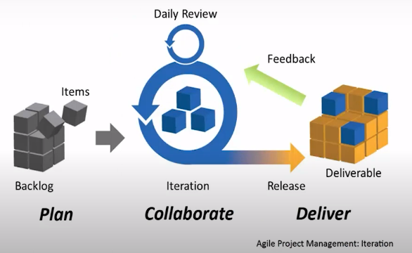
Agile Methodologies

Slide 13
Agile vs. OSSD Methodologies
As per Agile Manifesto :
“Our highest priority is to satisfy the customer through early and continuous delivery of valuable software “
As per OSSD Model :
The concept or analogy of customers does note exist in open source software . There are contributors and users of the projects / product.
The user community , indirectly , serves as the customers; frequent releases are made - in order to promote peer review, continuous and increased end user involvement.

Slide 14
Agile vs. OSSD Methodologies
As per Agile Manifesto :
“ Welcome changing requirements , even late in development . Agile processes harness change for the customer ‘s competitive advantage “
As per OSSD model :
Open source projects are not customer driven ; and hence often resist incorporation of major changes in the requirements.
However , there always exist the possibility of incorporating major changes by forking the project in to as separate repository and making changes - done in case a larger set of community feels the need for the same.

Slide 15
Agile vs. OSSD Methodologies
As per Agile Manifesto,
“Deliver working software frequently , from a couple of weeks to a couple of months , with a preferences to the shorter time scale”
As per OSSD model,
Open source follows the philosophy of : release early , release often
Delivering of code cycle in case of open – source is much shorter – usually every night.

Slide 16
Agile vs. OSSD Methodologies
As per Agile Manifesto
“Business people and developers must work together daily throughout the project”
As per OSSD model ,
There does not exist the concept of “ Business people “ in case of open – source projects ;
However , end-users who participates in the project serve the same role.

Slide 17
Agile vs. OSSD Methodologies
As per Agile Manifesto ,
Build projects around motivated individuals . Give them environment and support they need , and trust them to get the job done”.
As per OSSD model :
Participation in open source projects is completely voluntary; self–motivated and self-driven people join open source community , out of interest and hence motivation is guaranteed
Open source projects use selected tools for project management , version control , bug and issue tracking and discussions forums.

Slide 18
Agile vs. OSSD Methodologies
As per Agile Manifesto
The most efficient and effective method of conveying information to and within a development team is face to face conversation.“
As per OSSD model :
This is a major point of differences between Agile methodologies and open source
Open source projects lay complexly emphasis on written communication over face –to-face communication
Additionally open source projects can be widely distributed , and do not require collocation

Slide 19
Agile Vs. OSSF Methodologies
As per Agile Manifesto :
At regular intervals, the team reflects on how to become more effective , and then tunes and adjust its behaviour accordingly.
As per OSSD Model :
Self reflection is not a major activity carried out in most of the open source projects.
However , some of the mature open source projects tends to evolve and implement some governance mechanism

Slide 20
Agile vs. OSSD Methodologies
As per Agile Manifesto
“Working software is the primary measure of progress“
As per OSSD Model :
This principle perfectly holds true for the open source software development model as well.

Slide 21
Agile vs. OSSD Methodologies
As per Agile Manifesto
“Agile process promote sustainable development . The sponsors , developers and users should be able to maintain a constant pace indefinitely. “
As per OSSD Model :
  The spirit behind this principle is in some manner embraced by open source;

Slide 22
Agile vs. OSSD Methodologies
As per Agile Manifesto :
“ Continuous attention to technical excellence and good design enhances agility”
As per OSSD Model :
Open source model emphasize heavily on good design , technical excellence and well written documentation

Slide 23
Agile vs. OSSD Methodologies
As per Agile Manifesto :
The best architecture , requirement and design emerge from self –organising teams
As per OSSD Model,
Although, open source projects might not state this explicitly , but the underlying philosophy behind the open source projects makes this being true for these projects.
Self organising and self motivating community does results in some of the best products , with best architecture and designs

Slide 24
Agile vs. OSSD Methodologies
As per Agile Manifesto
“Simplicity – the art of maximizing the amount of work done is essential “
As per OSSD Model,
since open source projects mostly rely on Voluntary commitments, and not contractual commitments , hence the amount of work done is never a point of major concerns
The amount of work to be done wholly depends on the belief of the individual developers.

Slide 25
Conclusion
To summarise :
While both agile and open source methodologies embrace a number of principles and values , some of which are parallel , but some are intersecting as well.
However , both of them :
Involve continuous interactions with users during all phases of the development;
Value good design and effective documentation
Engage self organising and self motivated individuals ; and
Strive to develop software that is tailored especially for a class of users / customers

Slide 26
Recommended Practices
Corporates can benefits from adopting certain practices :
Increased team communication
End user feedback
Peer review
Release early and often
Transparency
Good code designs

